Slide 1
10/17/18 Weekly Meeting Update

Slide 2
General
Received a lot of parts in the mail → working on testing
Talked to Kelly → suggested agricultural application
Ripening fruit gives of ethylene → very important to monitor precisely (ppb)
Can’t find a reasonable sensor we could use
Talked to Wettergreen → said collaboration with FE&P not worth it, gardening is boring
Likes air quality and wants to put us in contact with someone affiliated with Air Alliance Houston/Breathe Houston http://breathehouston.org/

Slide 3
Sensor Update
Emailed Riccardo Petrolo asking about gas sensors in general
Says that PM2.5 sensors are good general air quality sensors
Going to order a particulate (dust) sensor for first prototype

Slide 4
Power
Have parts needed: solar cells, charger, batteries
Talked to Erik, we should automate testing:
Have an MSP430/Arduino control charger and record time
Going to consult Benjamin/Erik after designing testing system
Currently scouring UG for a proper system
Reading data sheets is hard
Desires:
System built by weekend
Data collected next weekend
2nd desire depends on 1st
Test indoors and outdoors on at least
One solar cell configuration
One EH IC configuration
Enough info for a first prototype, move on to PMICs
Battery
Solar Cells
BQ25505 EVM
Load (transistor, resistor, LED)
MSP430

Slide 5
Communications
Working on getting current draw measurements
Just grabbed battery, working on way to nicely add resistor to measure from
Not as simple as original hoped since battery has a connector, not just wires
Ran quick tests with Featherboard
Able to pair to phone, but data not being pushed
Looking into it
Future Work:
Get current measurement from Feather today
Get feather code working
Port code over to MSP430
Get current measurement from bluefruit
Range Test of bluefruit

Slide 6
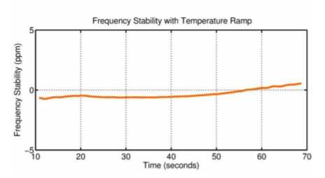
Other
External Oscillator
Frequency tolerance:
0.005% = 50 PPM
0.0005% = 5 PPM e.g. 33 kHz means min. 32999.835 Hz and max. 33000.165 Hz
SiTime SiT1576 ($19 on Digikey)
1 Hz to 2.5 MHz
± 5 ppm
4.5 µA at 33 kHz typ.
SiTime SiT1566 ($2 on Digikey)
32.768 kHz ±3 ppm, ±5 ppm
4.5 µA typ., 5.3 µA max
External Memory
64 bit precision in sensing * 24 hours * 7 days = 1.3 KB
Our MSP430 has 256 KB of FRAM so we should be good
Notes:
PPM Calculator

Slide 7
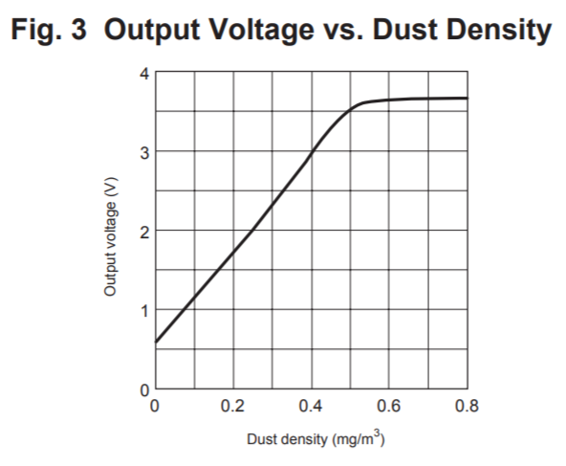
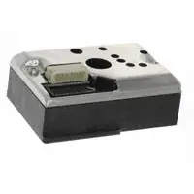
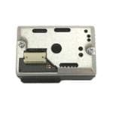
Infrared emitting diode (IRED) and phototransistor detects the reflected light of dust in air. In addition it can distinguish smoke from house dust by pulse pattern of output voltage.
Particulates: post-disaster (Hurricane Katrina, 9/11)“shelter cough”
Optical dust sensor PM10 (reports density)
Recommended supply 5V (but some tutorials show 3.3V), max current 20mA (typical 10mA)
Digi Key
Data Sheet
GP2Y1030AU0F
3V to 5.5V operating supply voltage, 27 mA
0 to 500µg/m³ dissipation concentration
Internal cleaning
PM2.5 and PM10 sensing discrimination
Guideline levels of PM10 (density of 10 μm particulates):
20 μg/m3 annual mean
50 μg/m3 24-hour mean
(from World Health Organization)

